Slide 1
Master of Nutrition.

Slide 2
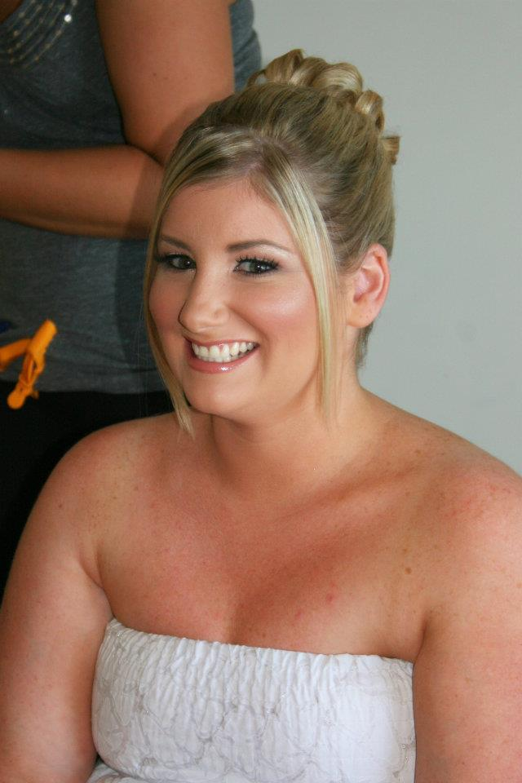
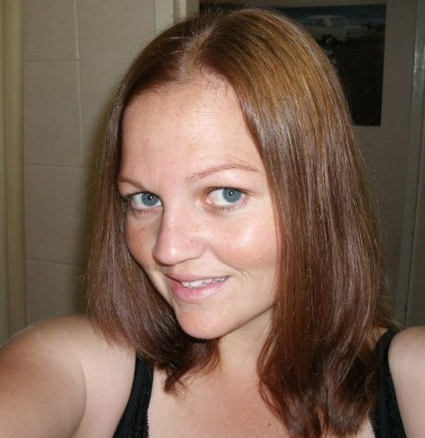
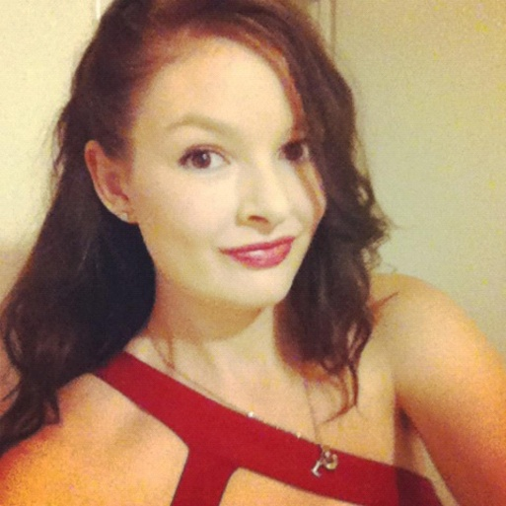
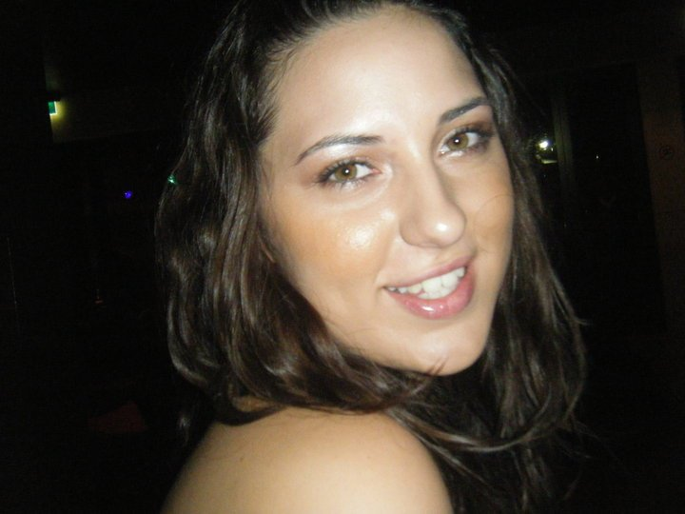
Created by
Dani Ekins
Sarah Fullard
Leah Potkin
Amy Panté

Slide 3
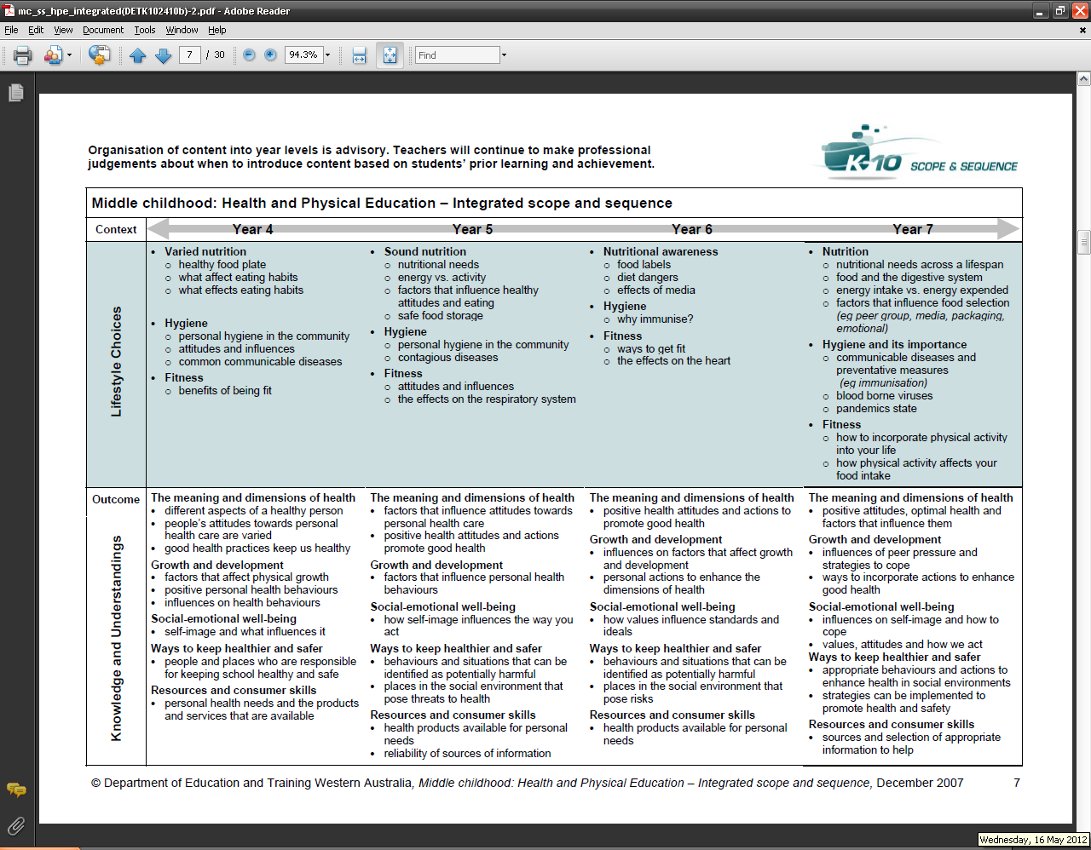
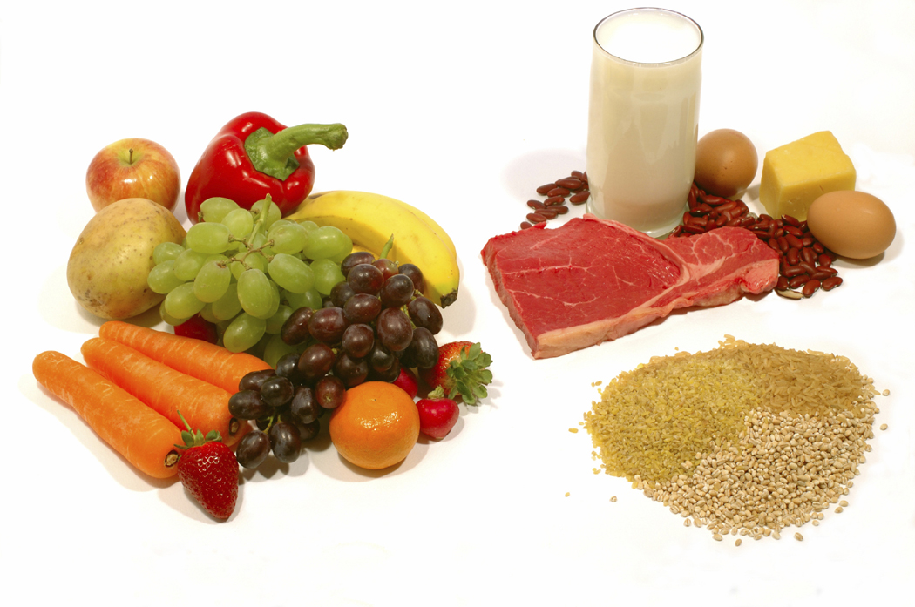
Topic: Nutrition

Slide 4

Authentic Task

Slide 5



Process

Slide 6
Reflection

Slide 7
Over to our wiki....

Slide 8
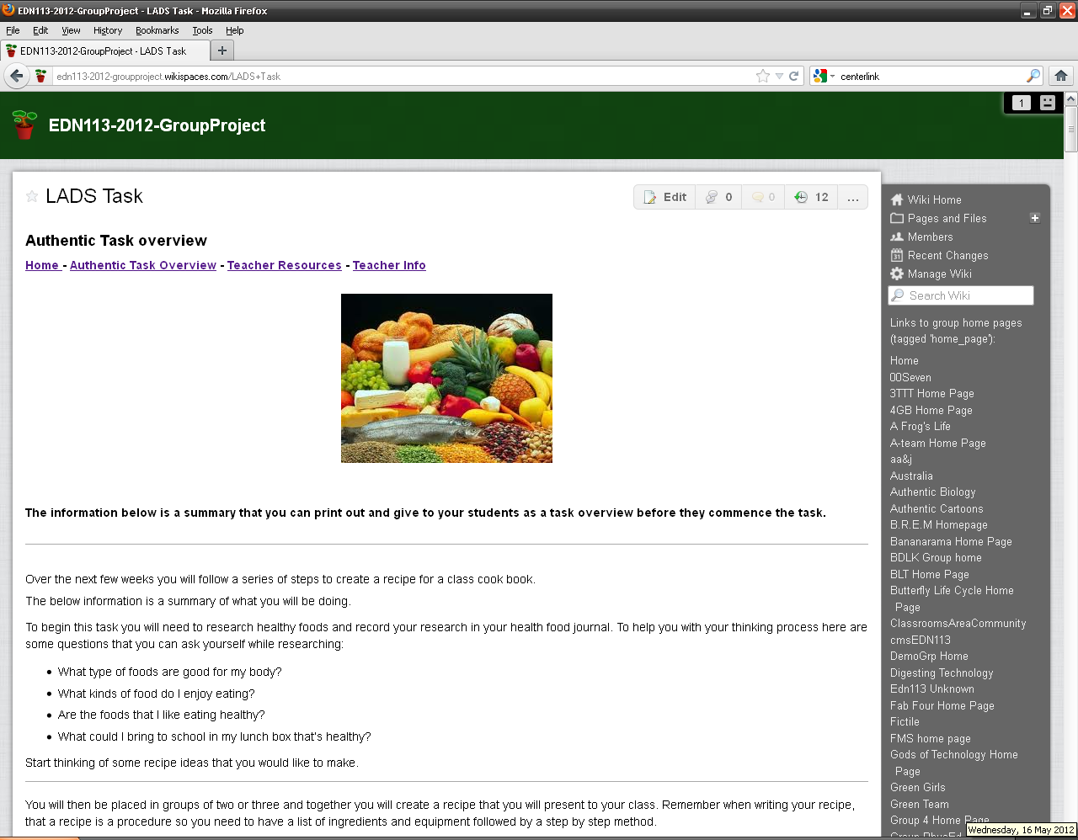
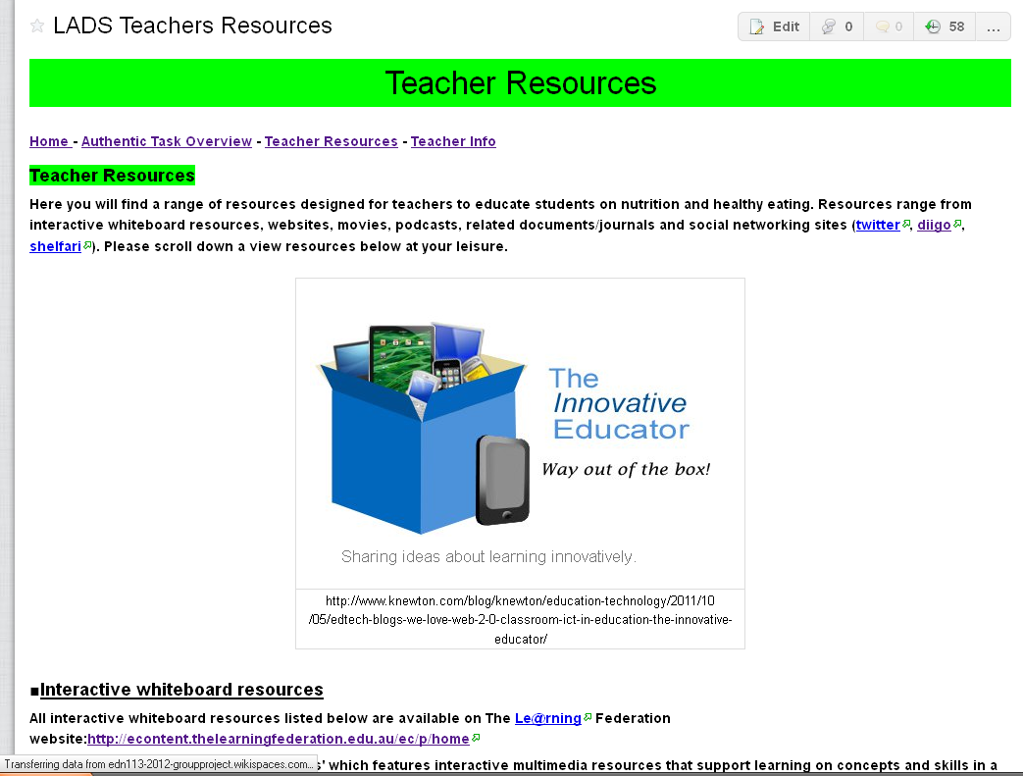
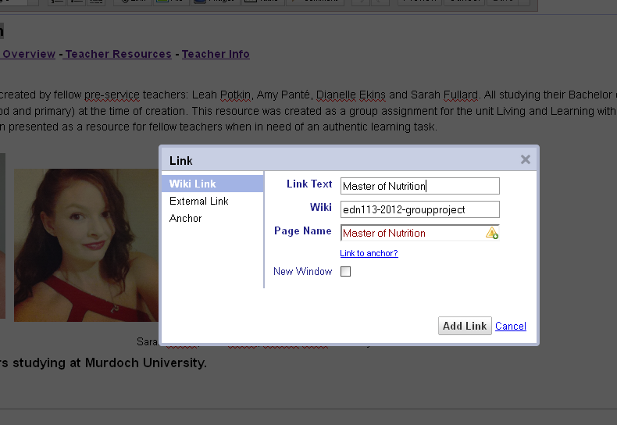
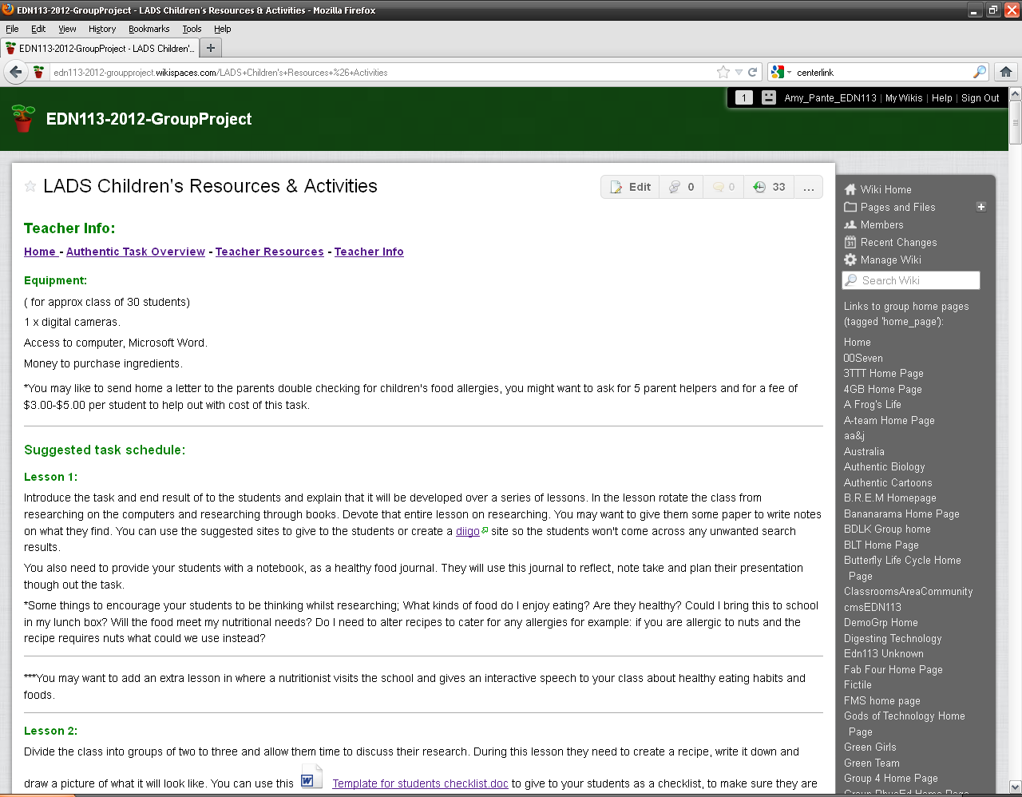
Development of Wiki
Amy, Sarah, Dani and Leah worked together to construct the homepage and all had equal input to ideas of the task.

Slide 9
Thank you for viewing Master of Nutrition

